Slide 1



103rd Promenade Nationale
VAVS Program
Radisson Hotel and Conference Center
Green Bay, WI.
September 14, 2022

Slide 2

About the Presenter
Ron Rolfes
- US Air Force Retired
- Nationale Directeur VAVS/SVH
- VAVS Nationale Representative
- Co-Chair Partnership Sub-Committee on the VAVS National Advisory Committee
- Sous Chef de Chemin Der Fer 2005, Sous Directeur Membership 2001-2004, Grande Chef de Gare du Germany 1999
- 33 years of membership with La Societe

Slide 3
About the Presenter
John Edelblute
-Sous Directeur VAVS/SVH Area III
- Grande Chef de Gare, Grande du Wisconsin

Slide 4

Who is in the Room?
National Officers
VAVS Sous Directeurs
Grande Officers
New VAVS Reps/Deps
Seasoned VAVS Reps/Deps
Other CDCE (VAVS) Volunteers

Slide 5
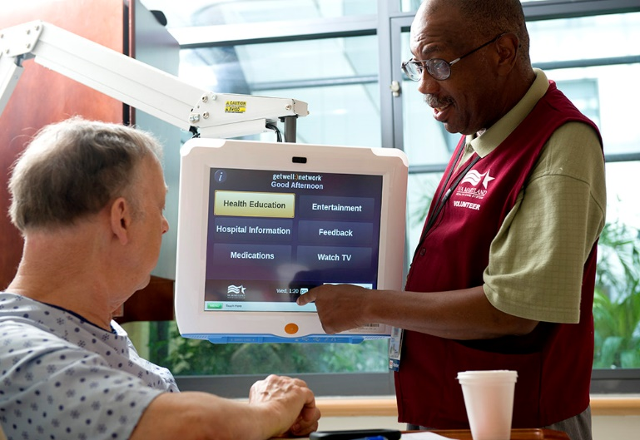

What We’ll Cover
Overview of VA CDCE Program & snapshot of statistics
Organizational Structure
Purpose of the National Advisory Committee
Responsibilities of Reps/ Deps
Priorities moving forward

Slide 6
VA Center for Development & Civic Engagement (CDCE)
OverView
VA’s CDCE Program (previously VAVS), founded in 1946 is one of the largest volunteer programs in the federal government.
VA’s CDCE Program’s mission is to provide a structured volunteer program under the management of VA compensated employees in cooperation with community resources to serve America’s Veterans and their families with dignity and compassion
CDCE supports VA and VHA strategic goals by recruiting, supporting and retaining a knowledgeable, diverse and engaged supplemental workforce
CDCE (formerly VAVS) has provided 76 years of service, and during that time VAVS volunteers have accounted for more than 805 million hours in service to our nation’s heroes

Slide 7
CDCE Overview
Key Definitions
Without Compensation (WOC) -Volunteers accepted in the CDCE Program are considered WOC employees. WOC precludes monetary payments, or any form of compensation by VA not authorized by policy.
Regularly Scheduled (RS) Volunteers - RS volunteers are individuals who have registered to participate in the CDCE Program in a regularly scheduled assignment under VA supervision and who have completed a volunteer orientation. (Frequency of participation is determined locally)
Occasional Volunteers (OV) - Occasional volunteers are those individuals serving under the CDCE Program who do not meet the requirements of RS volunteers. Individuals frequently volunteer with a group or organization on an occasional basis.
Student Volunteers - Student volunteers under the age of 18 must have written parental or guardian approval to participate in the CDCE Program. The minimum age for volunteers is determined by facility management.

Slide 8
What’s your Why?
Why do you volunteer??
Open Discussion

Slide 9




CDCE Annual Impact
Volunteers: 25000 + (Prior to pandemic 68000 +)
Hours of Service: 2.6 Million (9.5 Million)
Donations: $101 Million ($89 Million)
National and Community Partnerships: 7,400

Slide 10

VA Organizational Structure
Secretary of Veterans Affairs
The Honorable Denis McDonough
Veterans Benefits Administration (VBA)
Executive in Charge
Thomas Murphy
Veterans Health Administration (VHA)
Executive in Charge
Dr. Shereef Elnahal
National Cemetery Administration (NCA)
Under Secretary for Memorial Affairs
Matthew Quinn

Slide 11
CDCE Organizational Structure
Sabrina C. Clark
Director
VA CDCE Office
VAVS National Executive Committee
VACO CDCE
Responsibilities
VAVS National Advisory Committee
Field Resource Team
CDCE VISN Liaison Chiefs
CDCE
Field Staff
Local VAVS Committees

Slide 12
National Advisory Committee (NAC)
Established by VA Circular No. 117 in 1946
Became a federally chartered advisory committee in February 1973
Advises the Secretary of Veterans Affairs, and is responsible for:
      Coordinating and promoting the VAVS program
      Communicating VA policies to various organization constituencies
      Making recommendations to improve VA CDCE services to Veterans

Slide 13
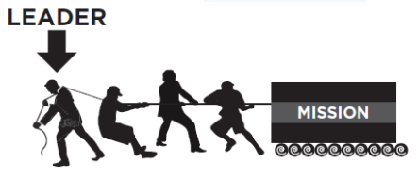
Responsibilities of the
VAVS National Representative (Directeur)
Official liaison between La Societe and CDCE CO in all aspects of the CDCE (VAVS) program
Assists Grande Chef de Gare’s, Correspondants or VAVS Directeur’s and the National Certifying Official in the selection and certification/decertification of local VAVS Reps/Deps
Provides initial guidance and information to local Reps and Deps

Slide 14
Responsibilities of the
Grande Directeur VAVS
Official liaison between his/her Grande and Nationale Directeur in all aspects of the VAVS(CDCE) program
Assists Grande Chef de Gare’s, Correspondants or Locale VAVS Directeur’s in the selection and certification/decertification of local VAVS Reps/Deps
Ensures that La Soceite is represented in all VA Facilities within his/her Area of Responsibility

Slide 15
Local VAVS Rep/Dep Responsibilities
Contact the Local CDCE (VAVS) Chief or designee upon receiving Certification
Complete orientation & training to become an RS volunteer
Assist with improving the CDCE (VAVS) program
Provide input/feedback to VA staff & VAVS Committee
Recruit volunteers
Promote donations of financial & material goods
Attend and participate in VAVS Committee meetings
Assist in the removal of organization’s volunteers when necessary
Serve on subcommittees and task groups
Maintain organization’s records (hours, donations)
Coordinate facility activities and projects
Conduct Annual Joint Reviews Advise & inform organization of CDCE (VAVS) and VA issues and concerns

Slide 16
Qualifications of a Great Volunteer
Sincere interest in the welfare of Veteran patients and a desire to help them
Ability to work with others
Leadership – “Most essential trait of a Rep/Deputy Rep”
Knowledge of La Societe and VA
Ability to communicate and disseminate information
And the most important qualification…

Slide 17
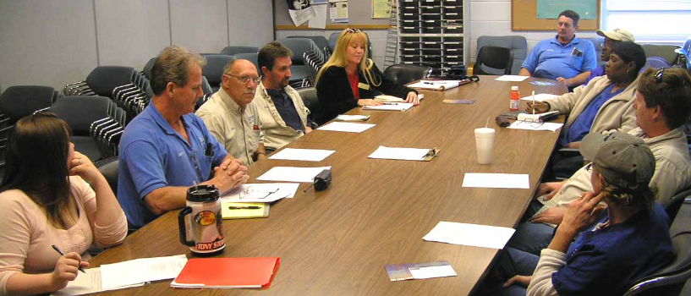
Ability to Attend….
Regularly Scheduled
VAVS Committee Meetings

Slide 18

Why Volunteer?
To gain work experience
To learn new skills
To meet new people
To give something back
To be of service to others
Social Interaction

Slide 19
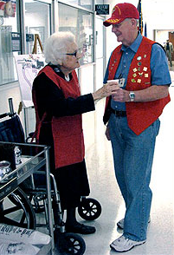

What Do Volunteers Do?
Patient Ambassador/Red Vest Volunteer
Patient Escort
Volunteer Drivers (DAV / VTN & Parking Lot Shuttle)
Clerical Positions
Information Desks / Guest Relations / Concierge Programs
Chaplain Service
Recreation Therapy
Nursing Service / Hospice / Palliative Care
Pharmacy Service
Waiting Room Attendants
Patient Meal Assistants
Respite Care
Notes:
Nate

Slide 20

Non-Traditional
Volunteer Assignments
Virtual Volunteers
Fundraisers for Special Projects
Volunteer Team Leaders
Recruiters
Speakers Bureau Organizer or Participant
Trainers & Educators
Writers (newsletters, recruitment ads, grants, social media posts)
Community Liaisons
Notes:
Nate

Slide 21
What You Can Do...
Ambassador / Greeter
Courtesy Coffee
Guest Service or Information Desk
Hospice/Respite Care
MOVE! Program
My HealtheVet
Recruit New Volunteers
Offer New Ideas
Get Involved!
Notes:
Nate

Slide 22
Challenges
Ensuring VA CDCE is viewed as a profession
Retention of volunteers (aging organization population, demographics, etc.)
Recruitment of volunteers (generational considerations)
Staff & volunteer education
New volunteer assignments & opportunities
  Episodic assignments
  Opportunities beyond Monday - Friday, 8:00 am - 4:30 pm
Personal identity verification processing including timely completion of an appropriate level background check
Notes:
Col. Gallina

Slide 23
Annual Joint Review
VA Forms 10-1240 and 10-1240a
Two forms:
VA Form 10-1240: Summary of Annual Joint Review
VA Form 10-1240a: Response to VAVS Summary Annual Joint Review
Purpose:
To assess organization’s participation in the CDCE program, communicate information to the National Representative, and receive feedback from the National Representative
Representative responsibilities:
Know the month the organization is scheduled for AJR
Make an appointment with the Chief, CDCE Service
Provide input into data, goals, objectives, and comments
Notes:
Nate

Slide 24

VA Center for Development & Civic Engagement (CDCE)
VHA Undersecretary for Health for Operations
Center: Enterprise-Wide Scope
Development: Expanded Partnerships, Services, Opportunities
Civic: Community, Belonging
Engagement: Cooperative, Communal, Collaborative
3 Business Lines
Voluntary Service: Our Foundation
Philanthropic Engagement: Our Relationships
Partnership Solutions: Our Impact—”Better Together”
Notes:
Taking all of this into account, VAVS was positioned to respond. We had actually been making the shift much earlier.
In 2018—VISN Liaisons met to begin discussion on Position Description with VHA Deputy Chief of Staff, Barbara Hyduke. She launched our partnership with Workforce Management & Consulting to work on the PD’s
In 2019 --- we started a discussion with the NAC, getting their thoughts on a name change, with the support of then VHA Chief of Staff, Jon Jensen, who was present at that meeting. Not everyone was thrilled about a possible change, but it seemed clear to most that it was necessary.
Work on the PD continues, almost done, but an organizational change happened first.
In January 2021, VAVS was realigned to the Assistant Under Secretary for Health for Operations, with memo that included the name change.
The Organizational Re-alignment is meant to bring:
1) Improved efficiency through the development of standardized operational processes across Veterans Health Administration for more consistency across the enterprise.
2) Greater facility-level program leadership and skill development through the adoption of established national professional standards and best practices in non-profit management and volunteer engagement.
3) Enhanced communication and visibility of the program to ensure that VHA leadership remain aware of the considerable role the community plays in support of quality health care throughout VHA facilities
CDCE-here’s a breakdown of how the name came about.
1) Center means that we are VA-wide, assisting with placing volunteers in National Cemetery and Veterans Benefits, even across staff offices in VA
headquarters.
(2) Development used industry wide to mean partnerships expansion, fundraising, exposing organizations to opportunities to be involved in our mission.
(3) Civic is linked to our mission as a public service organization, bringing the community into our work, with a sense that to accomplish our mission of service to Veterans, it takes all of us working together.
(4) Engagement- all of us working together means that there is a shared understanding of what needs to be done, ongoing dialog to ensure that we’re accessing the most needed and available resources, and an agreement that it’s not a single person, organization or idea that makes it work. It’s the collaboration.
We describe ourselves as having three business lines or functional roles that include:
1. Voluntary Service: Maintaining a core mission set and the most distinctive function of the office. Additionally, it will ensure that those legacy partners feel well-represented in the new name.
2. Philanthropic Engagement: Identifies a role that we always played, but often overlooked. Expands the scope of responsibility to working with diverse organizations, (including business/corporate, VSO’s, non-profits, foundations, and other community/civic organizations), soliciting and building strategic relationships. The term ‘engagement’ is significant’ as it implies the continual communication and relationship-building inherent in VAVS’ capacity, not just one-time donations for single projects.
3. Partnership Solutions: The partnership component is extremely important to note, as it represents the organizations currently partnering with VAVS and identifies this office as key contributor to VHA partnerships. The term ‘solutions’ implies that our work with our partners is and will be intentional and facilitated to address key issues for Veterans and opportunities for service enhancements. The redundancy here is intentional and critical with the number of organizations across VA utilizing partnerships continuing to grow a better VA together.

Slide 25

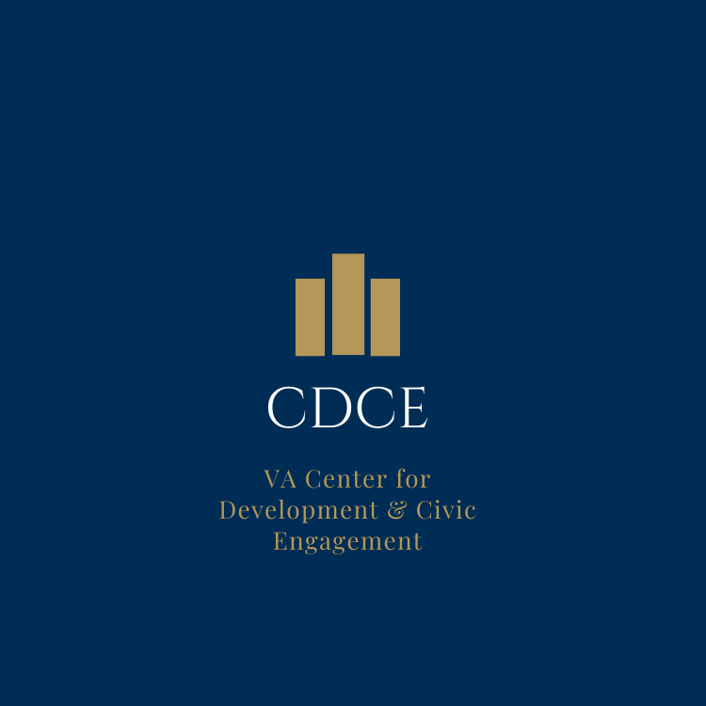
Building
the
Brand
Volunteer Transportation Network
Compassionate Contact Corps
VAVS Representative
Red Coat Ambassadors
Notes:
Here’s an idea for some branding maintaining the VAVS logo. The middle shows an idea for the CDCE logo. You’ll notice that the VAVS logo includes names of some of our major programs. Seeing it alongside a possible new CDCE logo is shown here.
Again, your volunteers are still VAVS volunteers.

Slide 26

What does the name change mean to…..
Facility Staff/Leadership
No fundamental operational change
Broader understanding of scope of services
Change in signage & marketing materials
Position Descriptions| Performance Standards | Hiring Implications
More questions!
Notes:
For staff and VA leadership, there is no fundamental operational change.
Nationally—the name change is in place. Our organizational code has changed : 15CDCE, CDCE rather than VAVS is our Acronym. Our Station Number is 126. Most important for you is 15/CDCE.
Locally—we want all programs to change to CDCE if they are “stand-alone” VAVS programs. If they have public affairs, or a Veterans Experience Office, or Patient Advocate—or some other key program attached and have changed their name to accommodate that—we do not suggest another change. But again, if they were Voluntary Service—or any derivative of that, CDCE brings:
Broader and more clarity added to the role of CDCE staff
Perhaps new signage and marketing materials
The name change will appear in the new PD being worked on, and we’ll include some tips/tools to help leaders understand how to measure success==beyond just numbers of volunteers and donations. Additionally—it will help HR Officers to understand how to identify qualified candidates when referring them for hiring actions. In April of 2021, a HR Management Letter rescinded very old guidance saying that volunteer managers could only be hired if they had volunteer management experience in VA in the past. Understand that this is a profession, with professional codes of conduct, ethics and standards.
And chances are---people will ask more questions, instead of assuming that they know who these managers are and what they do.

Slide 27
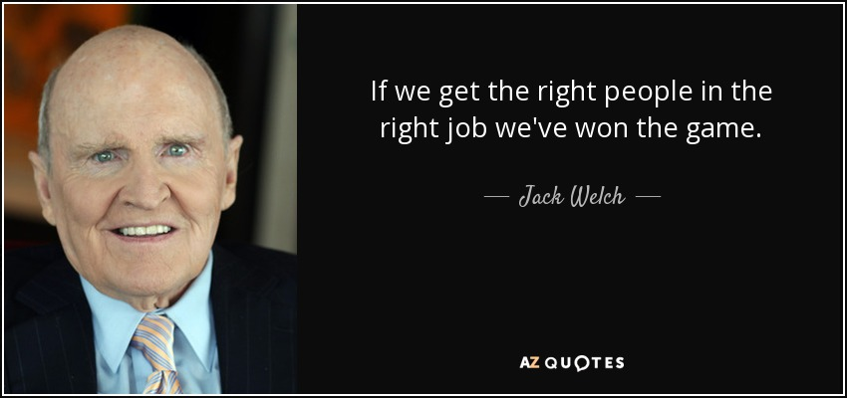
What does the name change mean to…..
VA & Veterans?
Upgrade of Professional Standards
Expansion of Volunteer Opportunities & Philanthropic Partners
Enhanced Recruitment, Retention & Succession-Planning
Professional Credibility
Grading Structure/Pay
Notes:
For VA and Veterans, it means that:
You can expect MORE, because we do more beyond place volunteers.
More partnerships, a diverse volunteer portfolio means that we’re building the types of programs and services that Veterans need.
I’m a business and if my experience in visiting your website helps me get to the place that can help my company facilitate a “Day of Service” right away, I’ll feel good about that. If I am working with another organization within VA, and THEY KNOW where to send me for this, I’ll feel good. Once meeting and having that good experience, I’ll feel confident that I can come to you DIRECTLY next time and may even want to do more.
Organizations that are well-led and managed warrant a greater level of community engagement and trust. VA will know WHO to look for when there is a vacancy.
And….with clearer descriptions of the work, they’ll be prepared to compensate them accordingly. This affects the BOTTOM LINE for EVERYONE INVOLVED.

Slide 28
The Power is
in the Ask!
Notes:
Col. Gallina

